Slide 1
Tender Hub
Scalable and Reliable Tender Management in the AWS with Elastic Beanstalk and RDS
Guide Name: Ms. Krushima Soma Designation: Asst.Professor
BATCH-3
2211CS030102 - M.Nandini 2211CS030103 - M.Srinija 2211CS030153 - Srinethri Shinde 2211CS030168 - V.Mamatha

Slide 2

Abstract
TenderHub provides a unified platform for administrators and bidders to streamline tender-related activities, ensuring clear communication and reducing inefficiencies.
The system minimizes paperwork, reduces errors, and automates workflows, improving operational efficiency and accountability.
TenderHub simplifies vendor management and bid evaluation, enabling better decision-making and reducing administrative overhead
TenderHub enhances transparency, reduces admin tasks, and
promotes fair competition.

Slide 3

Introduction
Traditional tendering methods often result in delays, miscommunication, and challenges in tracking tenders and vendors.
TenderHub centralizes all tender activities, improving transparency and enabling better collaboration between administrators and bidders.
The platform features an intuitive interface and automated workflows, making tasks simpler and more efficient for both administrators and bidders.
Hosted on AWS, TenderHub is scalable, secure, and reliable,
ensuring operational efficiency and fostering trust among
stakeholders.

Slide 4
Literature survey
"E-Procurement Systems and the Tendering Process" by L. L. Tsering (2019) explores how digital procurement platforms enhance efficiency, transparency, and collaboration in tendering processes while addressing traditional inefficiencies.
"A Comprehensive Study on Tender Management Systems" by S. Sharma and R. Singh (2020) examines the evolution, features, and challenges of modern tender management systems, emphasizing the role of digitalization in streamlining procurement processes.
"The Role of Automation in Enhancing Tendering Efficiency" by M. Wang (2021) highlights how automation technologies improve accuracy, reduce delays, and optimize workflows in the tendering process.

Slide 5
Existing System
Traditional tender management systems often rely on manual processes, spreadsheets, and legacy software, leading to inefficiencies and security risks.
1. Manual Workflows - Reliance on manual processes leads to errors, delays, and difficulty in tracking progress.
2. Data Silos - Data is scattered across multiple systems, making it difficult to gain a holistic view of the tender process.
3. Limited Scalability - Traditional systems struggle to scale to handle high volumes of tenders and complex workflows.

Slide 6
Proposed System
Centralized System: TenderHub consolidates all tender activities into one platform for seamless collaboration and access to up-to-date information.
User-Friendly Interface: The platform is designed with a simple, intuitive interface, making it easy for both administrators and bidders to use.
Automated Workflows: TenderHub automates administrative tasks, streamlining processes and enabling efficient bid management and tracking.
Scalable and Reliable: Hosted on AWS, the system is scalable, secure, and reliable, handling increasing demands with ease.

Slide 7
Methodology
Requirement Analysis and Planning: Gathered user requirements to define key features and roles.
System Design: Built a scalable architecture using Flask, AWS, and RDS.
Development and Implementation: Developed features iteratively with HTML, CSS and Bootstrap.
Testing and Quality Assurance: Conducted testing to ensure a bug-free, user-friendly platform.
Deployment and Monitoring: Deployed on AWS with continuous monitoring and updates.

Slide 8
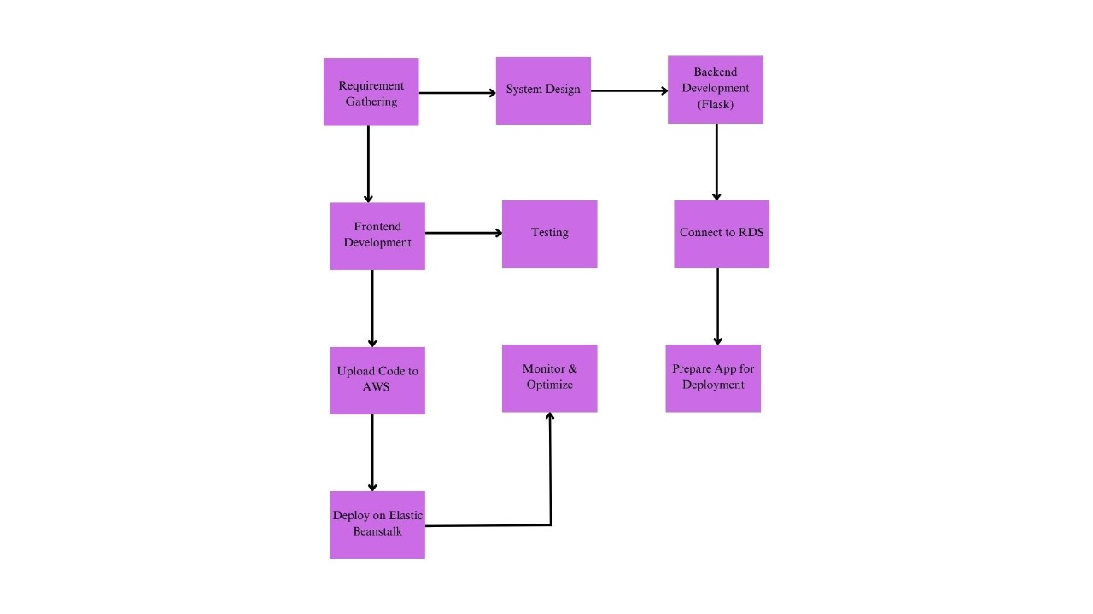

Slide 9
Conclusion
TenderHub makes managing tenders easier by bringing everything into one system, making it simple for both administrators and bidders to work together. Its easy-to-use design helps reduce manual work and improve efficiency. The platform keeps everyone updated in real time, ensuring fairness and trust. With cloud-based technology, TenderHub is reliable and can grow as needed. It helps administrators focus on important decisions while giving bidders a smooth experience. Overall, TenderHub is a valuable tool that saves time, cuts costs, and improves the tendering process.

Slide 10
THANK YOU

